Slide 1
Adaptive Motor Monitoring System Based on Machine Learning Batch Training
Fang Chen
Wentao Li

Slide 2
Project Background
What’s PHM
Why edge-computing
Current Fruit
Project Plan
Project Goal
Schedule
Staffing

Slide 3
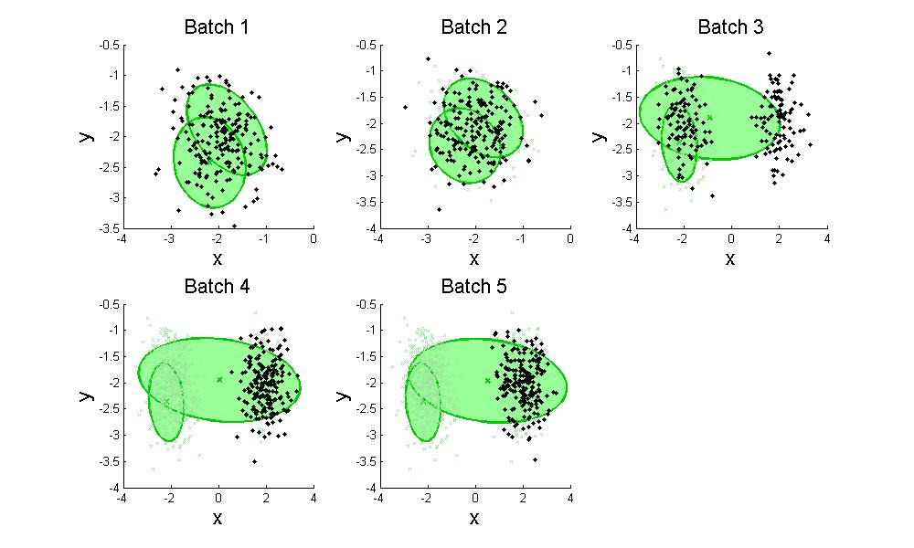
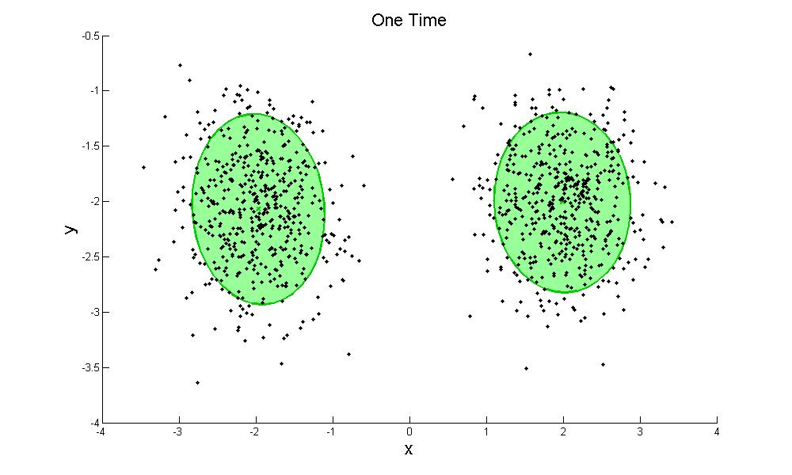
Solution: ML Batch Training

Slide 4
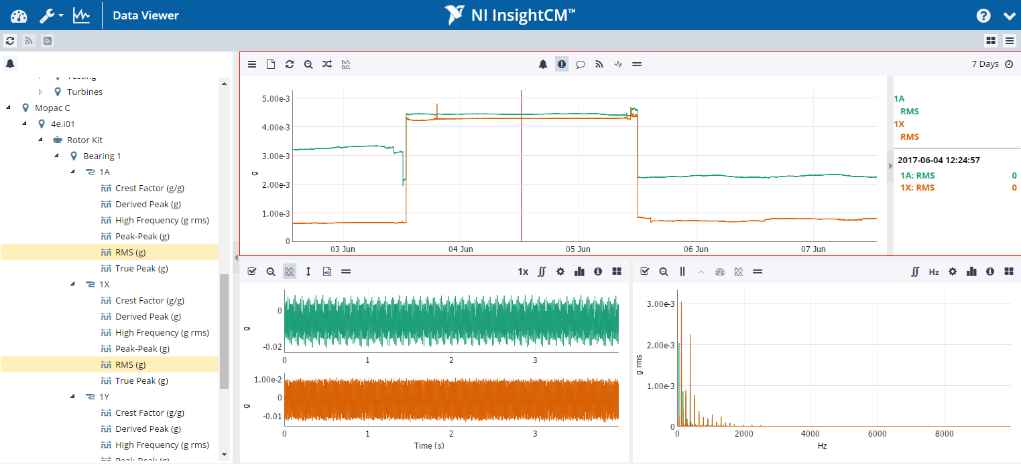
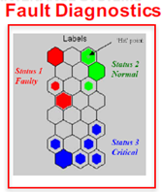


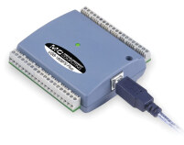

Solution: ML Batch Training
AI Algorithm
(Online Training)
Web Services
When a new condition is created(after a new maintenance process or changes to a new machine), the user could trigger a new process of online training on Pi.
When the training is completed, it will inform the user via web UI and start to monitor the real-time machine condition.
DAQ
Raspberry Pi

Slide 5
Expected Deliverables
A python-based library supporting batch/online training
Anomaly Detection（Health Assessment）
PCA-T2Q（mspc）
SOM-MQE
Performance benchmark based on embedded platform
Zynq
Pi
A good demo show
Better use case
Web UI
Linux Embedded System

Slide 6
PCA(第一优先级)
支持在线训练的算法可以参考附件中论文
Luckily, there have been some variations of PCA, one of them called SPCA uses a data-oriented method to calculate PC. What it does is that it updates PC adaptively whenever a new data sample comes in. Also its computational speed is very fast. So we could leverage its adaptability and computational efficiency to solve the problem mentioned above. More info please refer to:
https://www.sciencedirect.com/science/article/pii/S1088467X98000249
http://journals.sagepub.com/doi/abs/10.1155/2013/847612

Slide 7
SOM-MQE（第二优先级）
也是一种基于SOM的健康评估算法，网上有第三方的实现方法
The functions are transplanted from MiniSom by Giuseppe Vettigli, (see link:https://github.com/JustGlowing/minisom), which is licensed under the Creative Commons Attribution 3.0 Unported License. To view a copy of this license, visit link: http://creativecommons.org/licenses/by/3.0/.
SOM天生是支持逐点输入的

Slide 8
GMM-CV
目前不确定有没有在线训练的方法

Slide 9
仿真数据
Simulated文件夹下含纯仿真数据
电机数据稍后提供给你们

Slide 10
Milestones
下周一：论文理解
下周五：标准PCA实现及SPCA实现

